Slide 1
Magnetic induction
Magnetism of Rocks and Minerals
Rocks and minerals exhibit two types of magnetism.
1. Induced:- Induced magnetism is that which is
acquired by a body when subjected to a magnetizing
force. The intensity of magnetism acquired depends not
only on the nature of the material composing the body,
but also on the strength of the magnetizing force.
2. Remnant:- Some substances containing Iron, Nickel,
etc are however known to retain their magnetism more
or less permanently, even after magnetizing force has
been removed. They therefore said to posses remnant
magnetism.

Slide 2
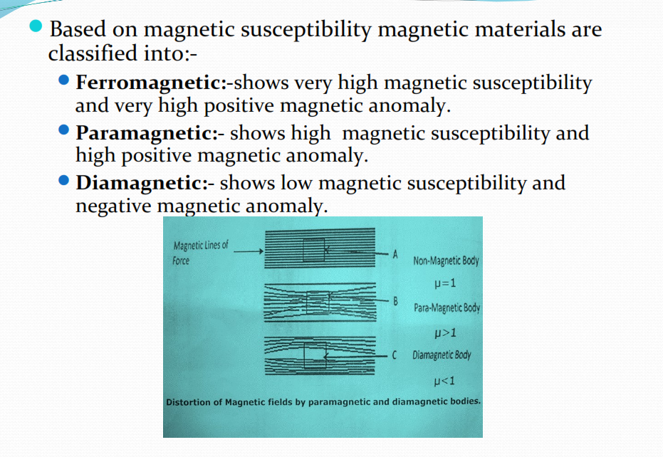

Slide 3
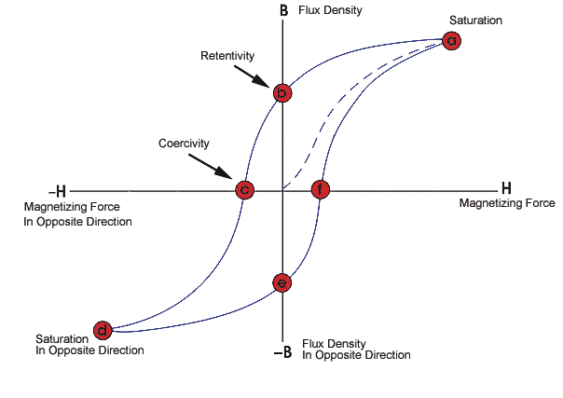

Slide 4
The magnetic hysteresis is the failure of the magnetization to return to its original state after the applied field is removed. the residual magnetization which is retained is called remnant magnetization. The magnetic field intensity required to reduce the remnant magnetization to zero is called the Coercive force.

Slide 5
Magnetic correction
The main corrections that are applied to the observed magnetic data before any interpretation is attempted.
The type of survey, the component measured, and the instrument used will dictate the type of correction.
However, the two main corrections are:
a- The Temperature Correction.
b-The Diurnal Correction. Other Corrections may include
C-Normal Correction (which include latitude and longitude correction.
D-Auxiliary magnet correction (for some instruments)
e- Vertical Intensity Correction (for horizontal (A H) measurement
f- Terrain Correction.
(i) If the anomalies are within (200 300 gammas) all corrections necessary. If the anomalies are very high (few thousand gammas corrections will not be significant.

Slide 6
Magnetic anomaly
The strength of Earth's magnetic field varies from place to place. As with gravity, a deviation from average readings is called an anomaly.
Very broad regional magnetic anomalies may be due to circulation patterns in the liquid outer core or to other deep-seated causes.
Smaller anomalies generally reflect variations in rock type, for the magnetism of near surface rocks adds to the main magnetic field generated in the core.
Rocks differ in their magnetism, depending upon their content of iron containing mineral, particularly magnetite.
A positive magnetic anomaly is a reading of magnetic field strength that is higher than the regional average.

Slide 7
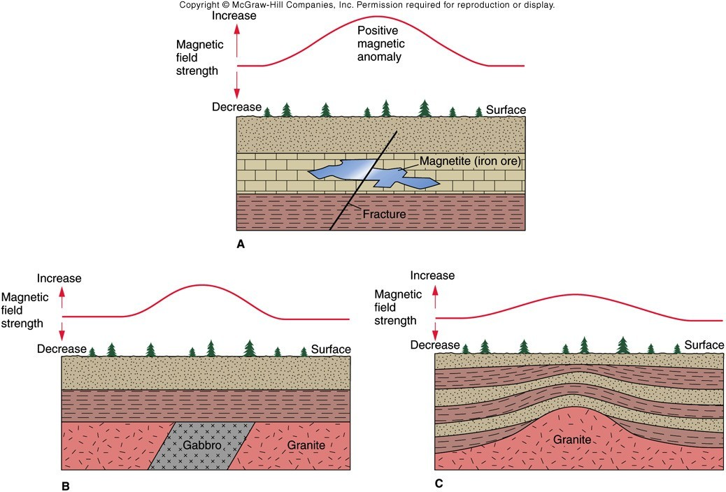
Earth’ s magnetic field
magnetic anomalies occur in local field from magnetic rock below surface (similar to gravity anomalies)
magnetic material below “ adds” magnetism
and creates positive anomaly
magnetic rocks include
iron ore, gabbro, granite

Slide 8
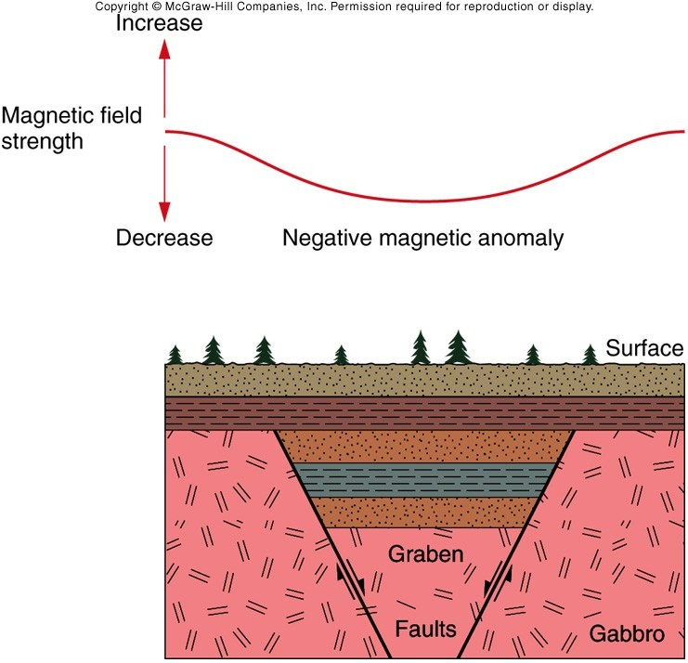
Earth’ s magnetic field
removal of magnetic material from near surface
causes negative anomaly (example is normal faulting)

Slide 9
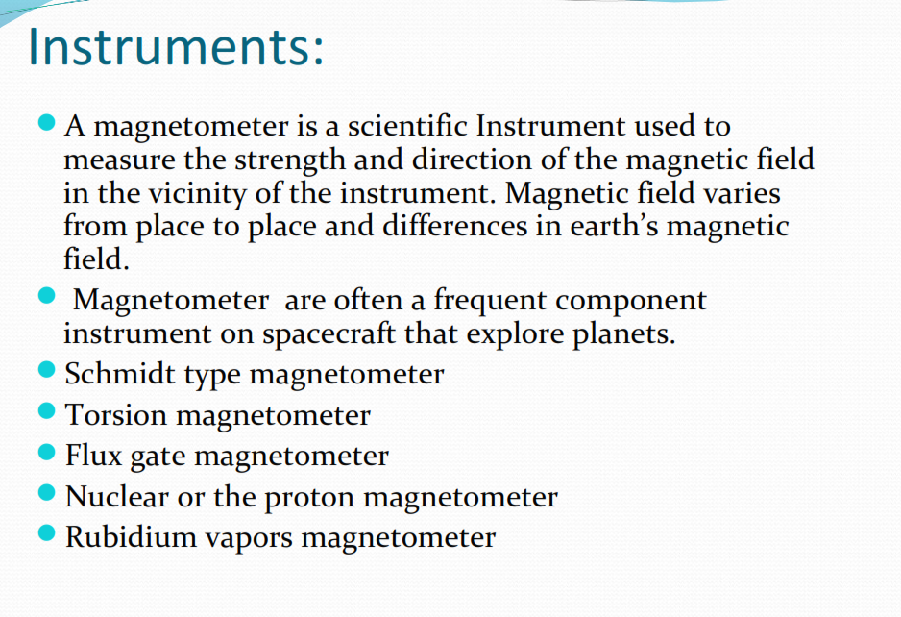

Slide 10


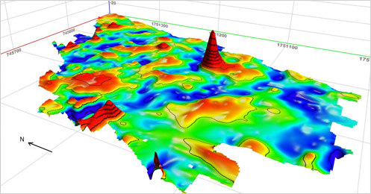

Slide 11
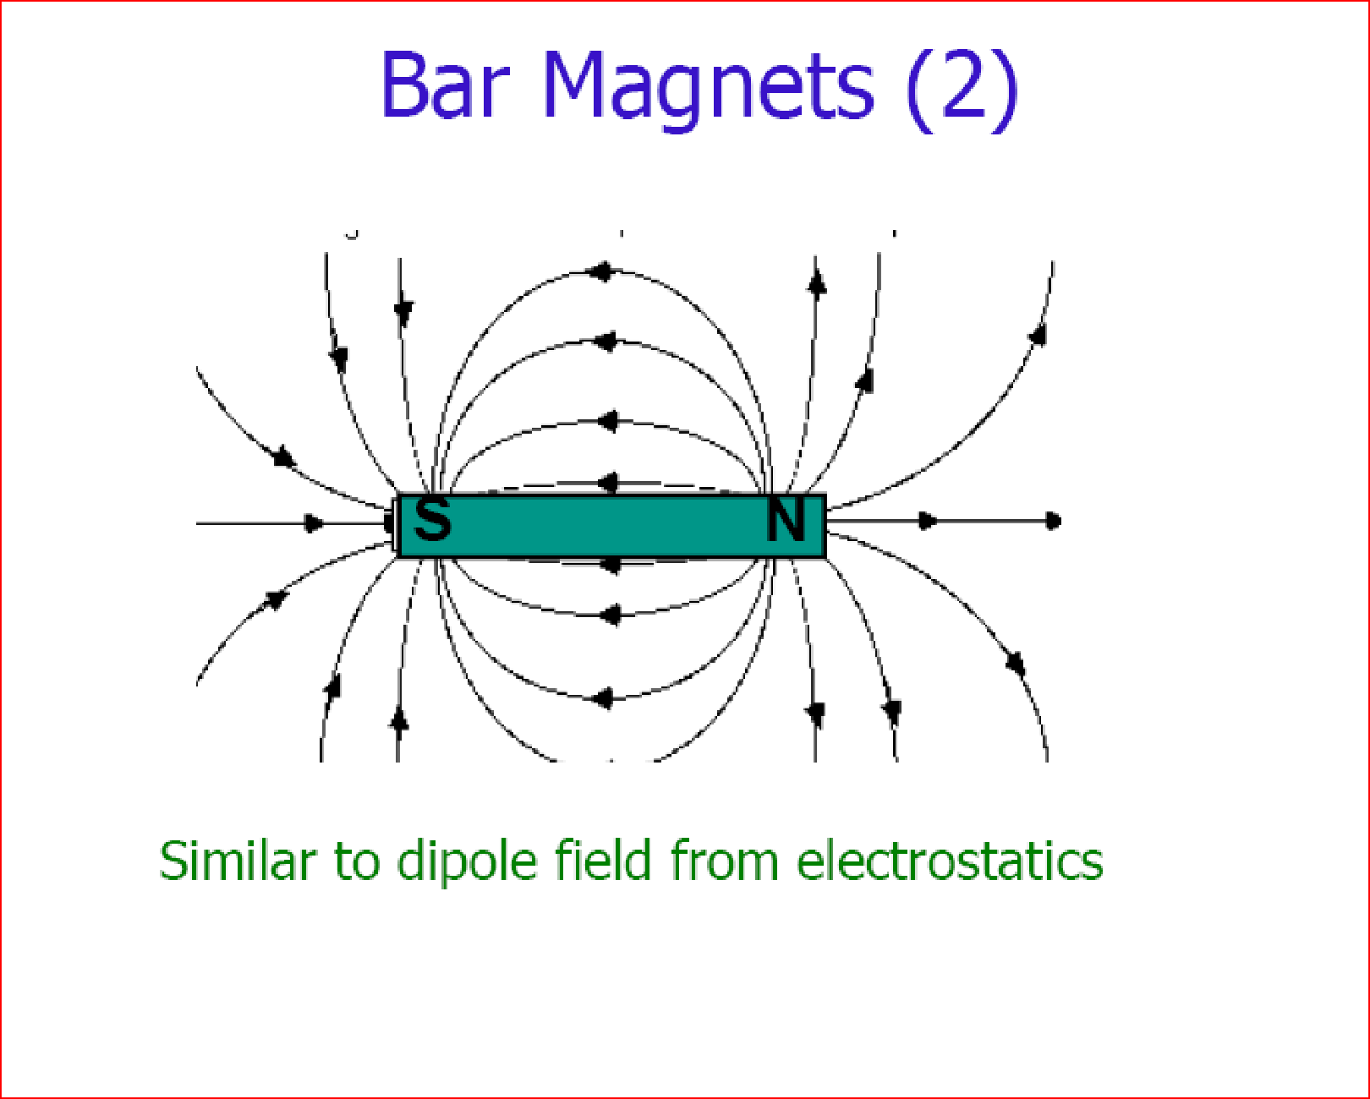

Slide 12
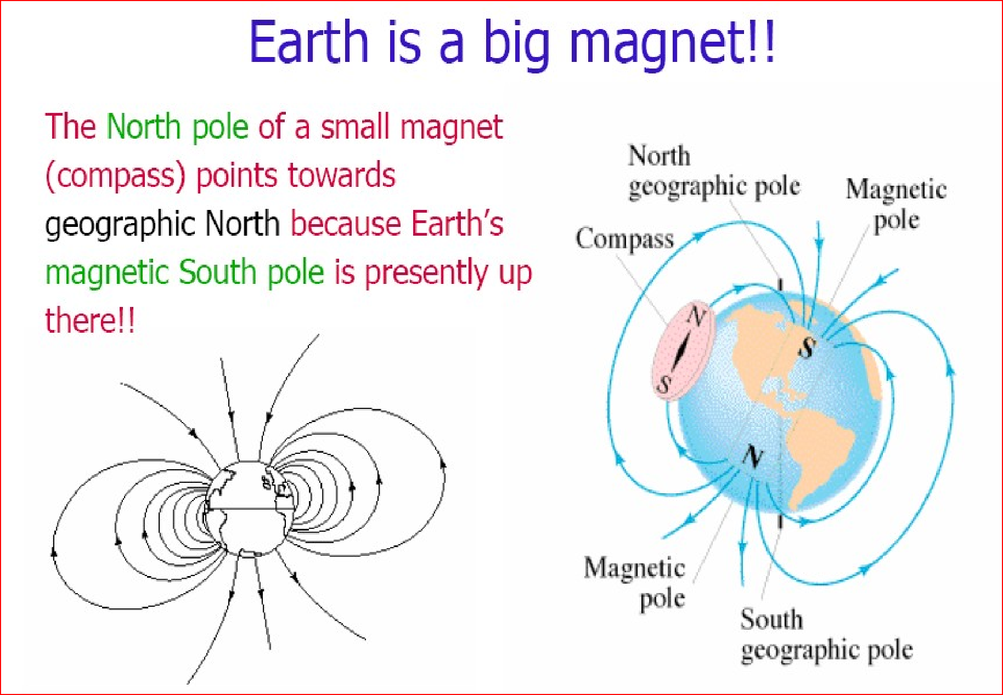

Slide 13
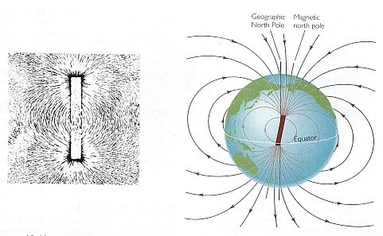
Earth’ s magnetic field
surrounds the Earth
has north and south magnetic poles
is detected by compasses
  is recorded in rocks and minerals as they cool
    is generated in the Earth’ s liquid outer core as it spins and produces electrical currents
Earth’ s field similar to that for bar magnet (left)
magnetic N and S is not the same as geographic
N and S poles (bar magnet “ tilted” )

Slide 14
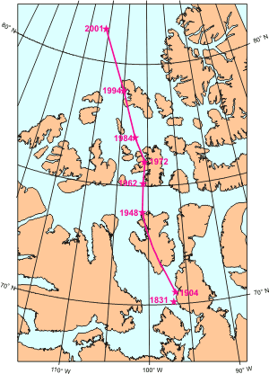
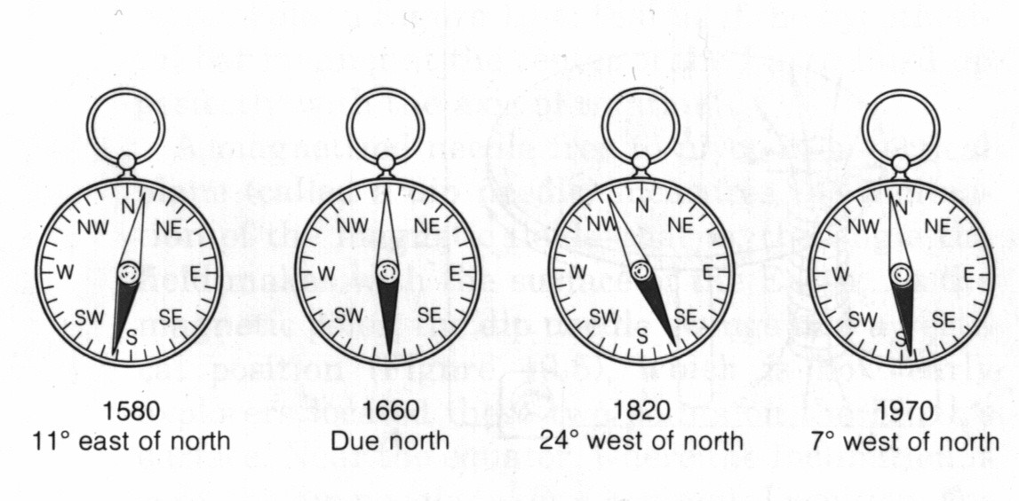
Earth’ s magnetic field
changes through time
change in magnetic north relative to true north
1580-1970
consequence of rotation of outer core
1831-2001
migration of magnetic north

Slide 15
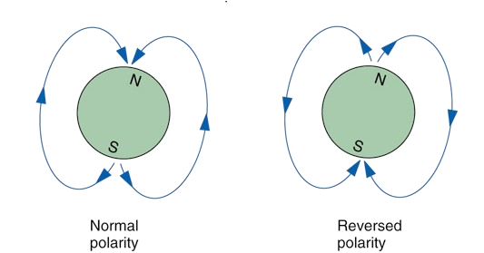
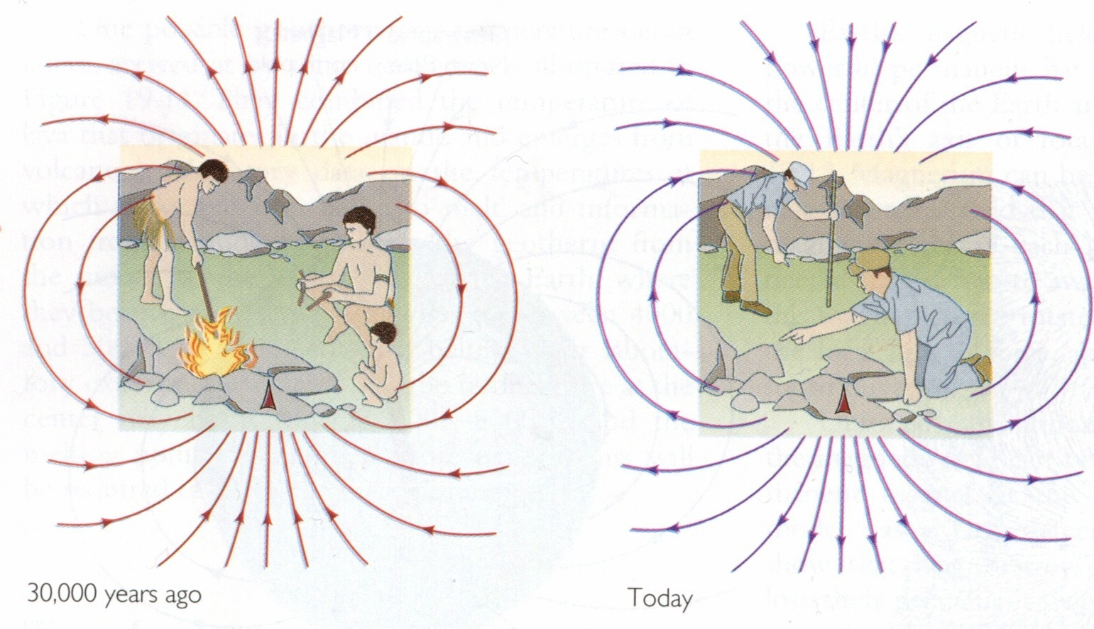
Earth’ s magnetic field
reverses over time (north and south poles flip)
--magnetic field lines reverse--
“ normal” polarity: north is north and
south is south
“ reversed” polarity: north is south and
south is north
after next reversal, compass needle will point south
S
N

Slide 16
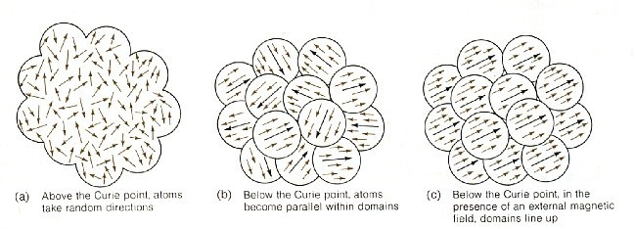
Earth’ s magnetic field
how do rocks and minerals acquire magnetism?
rocks and minerals at high temperatures (e.g. molten) must cool through their Curie temperatures
above Curie temperature, atoms are random
below Curie temperature, atoms align in domains that are independent of each other
below Curie temperature, atoms align with magnetic field if one is present (e.g. Earth)
1
2

Slide 17
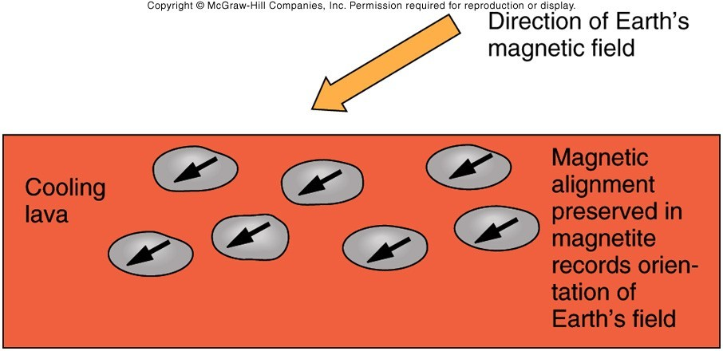
Earth’ s magnetic field
how do rocks and minerals acquire magnetism?
rocks and minerals that cool through Curie temperature
and stay below that temperature through time
record magnetic field AT THE TIME OF THEIR COOLING
paleomagnetism: study of ancient magnetic fields in rocks
--reconstruction of past fields--
magnetite common mineral in basalt

Slide 18
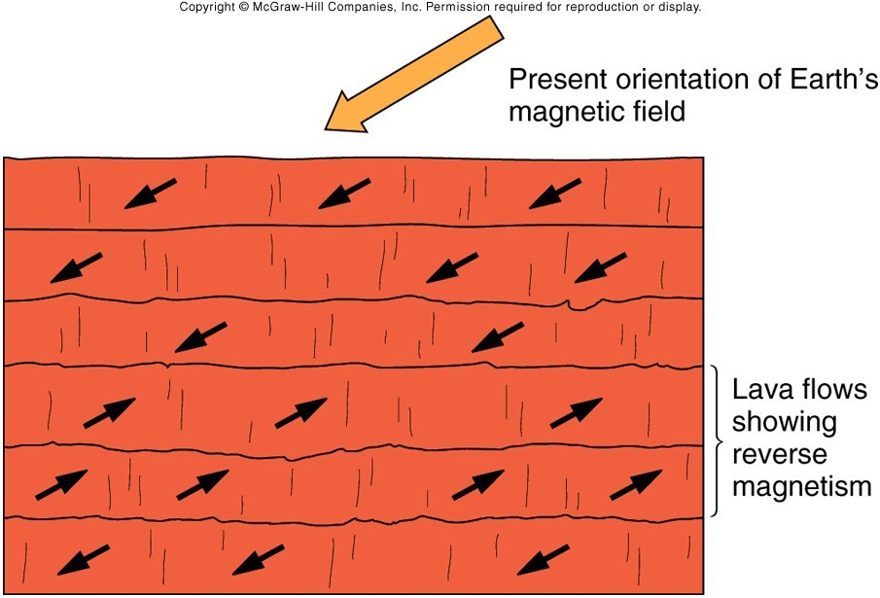
Earth’ s magnetic field
re-construct “ normal” and “ reversed” for lava sequence

Slide 19
Application of Magnetic Methods
1- Magnetic methods respond to ferromagnetic materials and can detect metallic objects composed of iron and steel, the vertical gradient of the magnetic field was measured. Vertical gradient measurements are more sensitive to small magnetic targets and typically have better anomaly resolution than total field magnetic measurements.

Slide 21
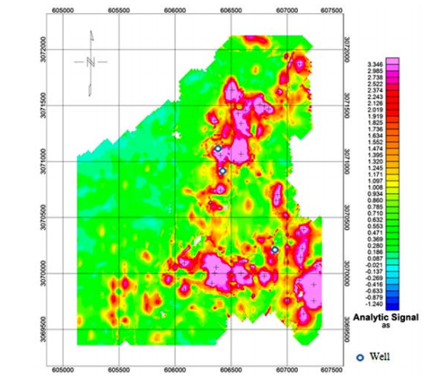
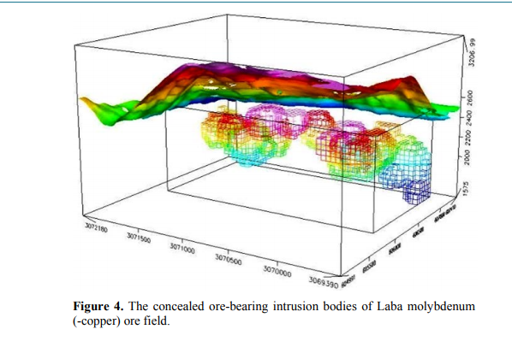
2- Magnetic Method Surveying and Its Application for the Ore-Bodies exploration

Slide 22
3- Applications of magnetic methods in oil and gas exploration:
Magnetic measurements for exploration are acquired from the ground, in the air, on the ocean, in space, and down boreholes, covering a large range of scales and for a wide variety of purposes
Aeromagnetic Sedimentary Residual Magnetic (SRM) Data Interpretation

Slide 23
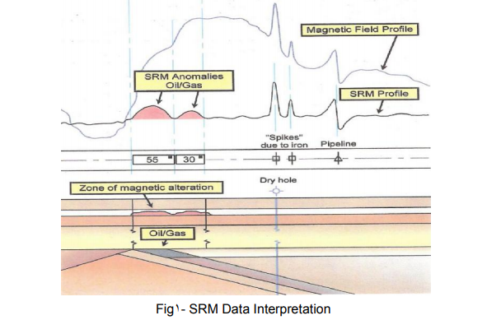
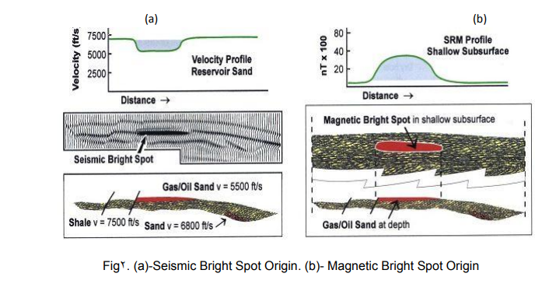

Slide 24
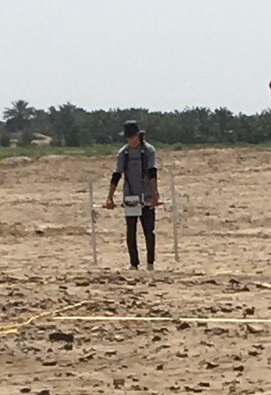

Archaeology
4-Using the magnetic method in the investigation of the Archaeological cites

